Slide 1

Miami Hack Week 2023

Slide 2
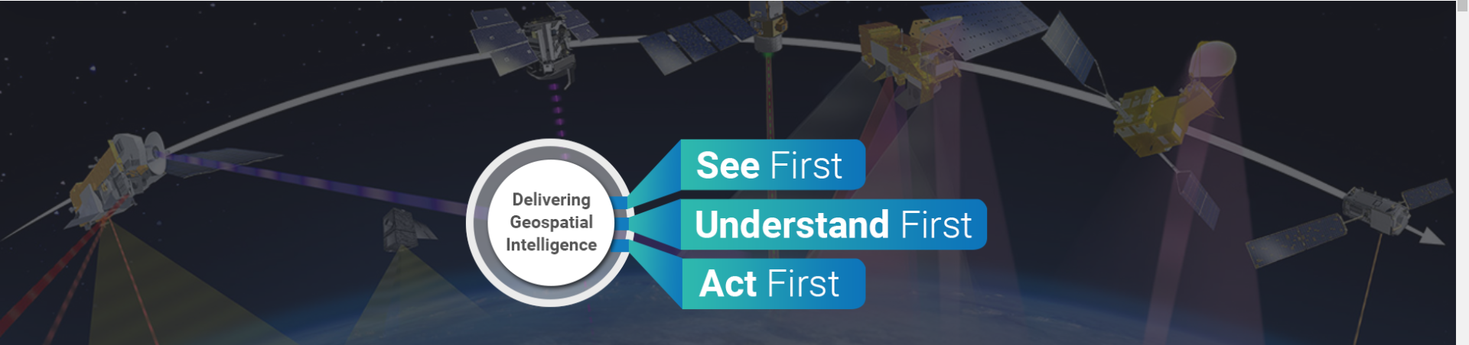
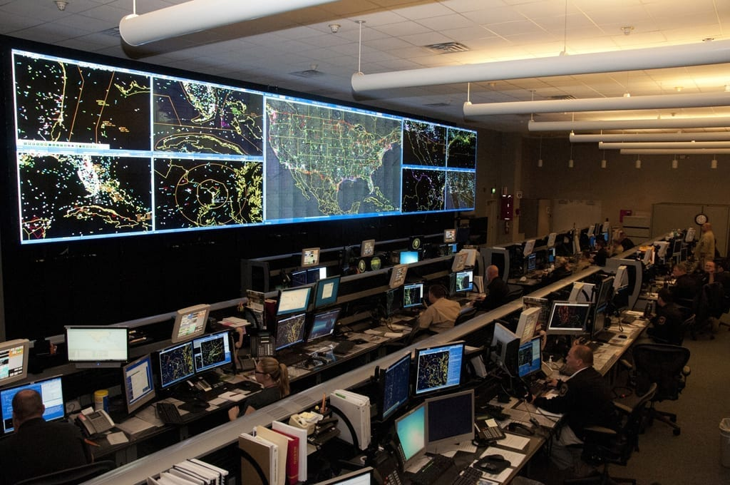
Maritime Intelligence with space-based sensor data
Automated multi-sensor, multi-database analytics with AI/ML
Space-based Sensor Fusion
Low Latency
In the Cloud and On the Edge
JOC/JIC Maritime Situational Awareness
Actionable Insight

Slide 3
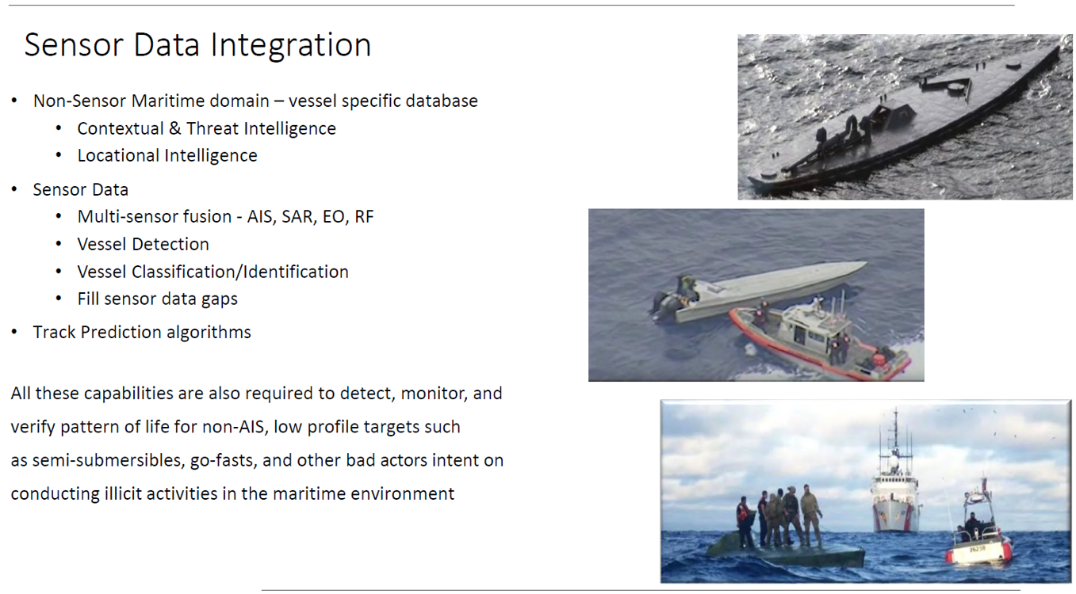
Non-Sensor and Sensor Data Integration for Maritime ISR

Slide 4
Data Types – AIS (Automatic Identification System)
Data | Field Name | Description | Unit
AIS | Longitude | Longitude in 1/10 000 min (+/-180 deg, East = positive (as per 2's complement), West = negative (as per 2's complement). | degree
 | Latitude | Latitude in 1/10 000 min (+/-90 deg, North = positive (as per 2's complement), South = negative (as per 2's complement). | degree
 | Timestamp | UTC second when the report was generated by the electronic position system (EPFS) (0-59) | UTC date
 | True Heading | Degrees (0-359) (511 indicates not available = default) | degree
 | COG | Course over ground in 1/10 = (0-3599) | degree
 | SOG | Speed over ground in 1/10 knot steps (0-102.2 knots) | knot

Slide 5
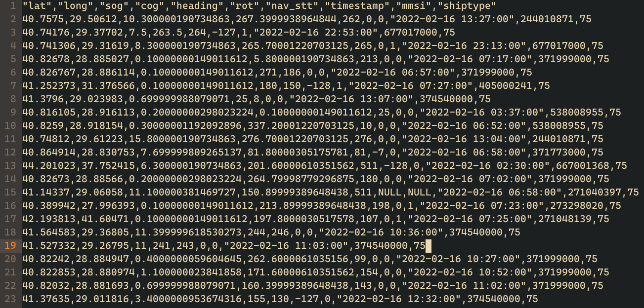
Data Types – AIS (Automatic Identification System)

Slide 6
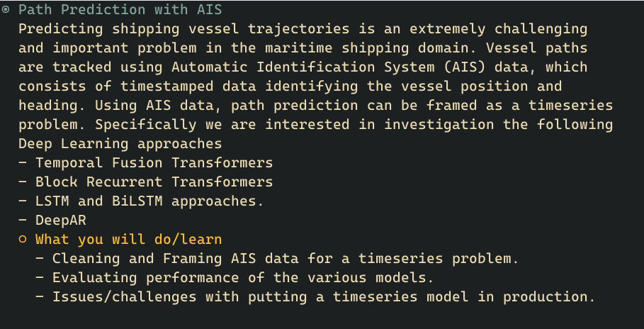
AIS Data Challenges

Slide 7
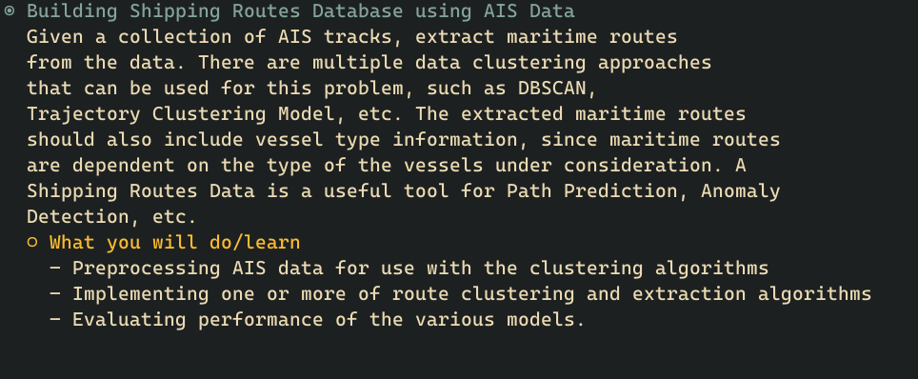
AIS Data Challenges

Slide 8
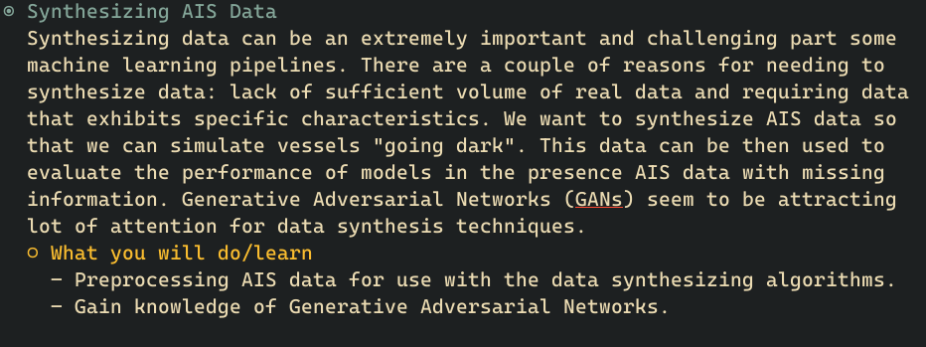
AIS Data Challenges

Slide 9
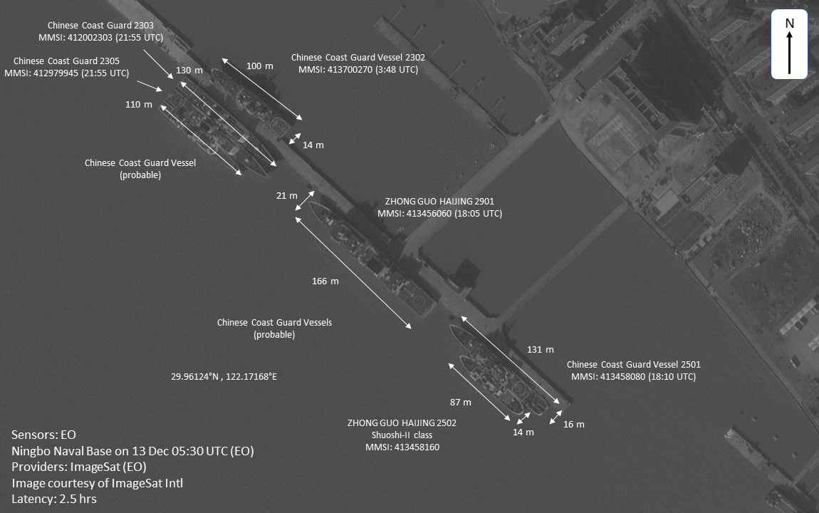
Data Types – Electro-Optical(EO) Imagery

Slide 10
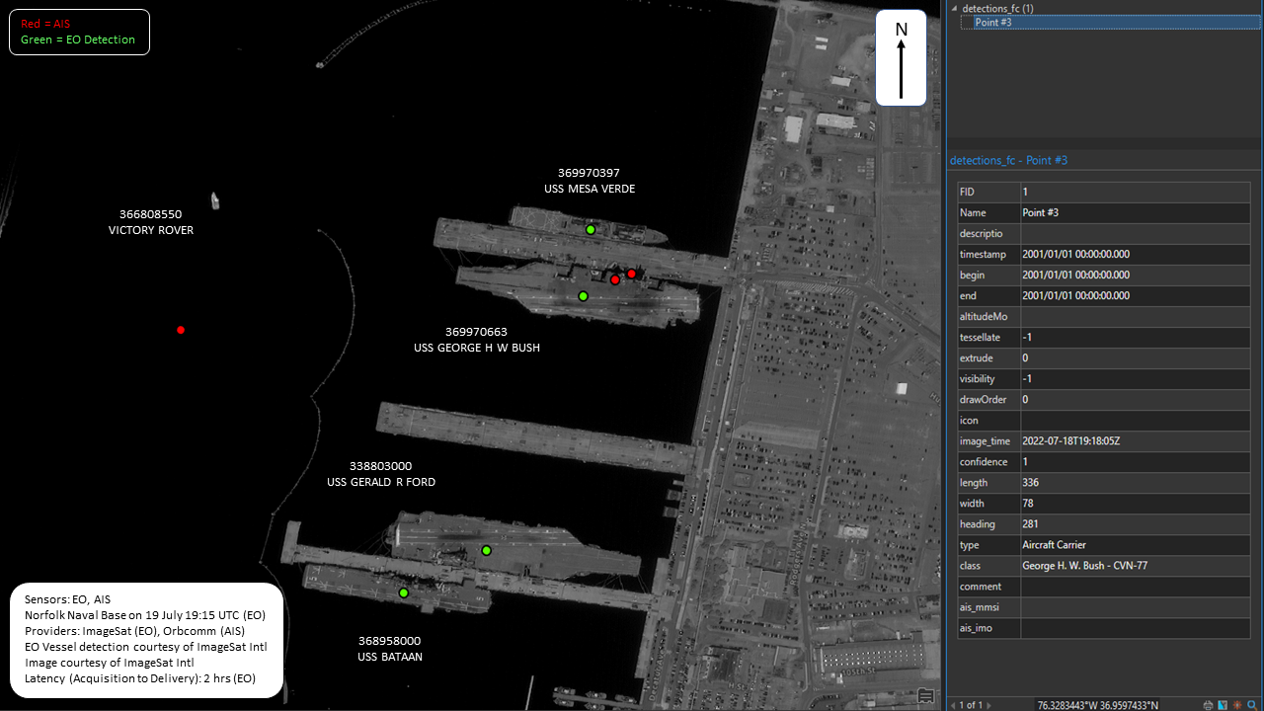
EO Imagery

Slide 11
EO Data Challenges
EO Image Segmentation to allow vessel detection
EO vessel detection with labeled training data

Slide 12
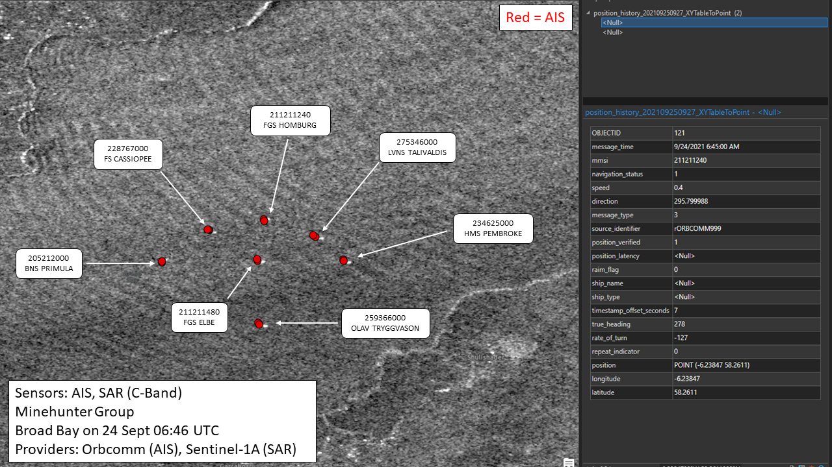
Data Types – Synthetic Aperture Radar (SAR) Imagery

Slide 13
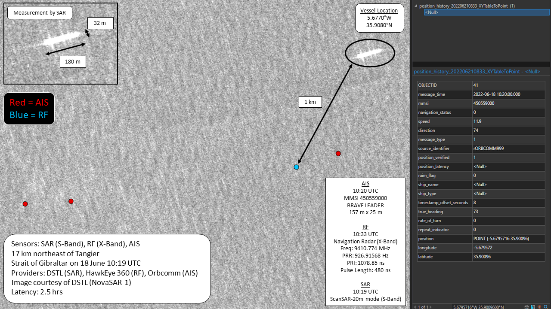
SAR imagery

Slide 14
SAR Data Challenges
SAR Image Segmentation to allow vessel detection
SAR Files can be large (multiple GB)
Segment images to allow for ML model training
Wake and/or heading detection
ML model to detect ship wakes for speed estimation
Determine heading of ships to obtain the full velocity vector
Vessel detection with labeled data
Develop an ML model to detect ships in a SAR image
Account for different data providers, imaging modes and polarizations

Slide 15
Multi-Sensor Data Fusion Data Challenges
Fuse EO & SAR vessel detections with the correct AIS messages

Slide 16
Accessing and working with the Data
Github Repo
S3 buckets
AWS Access

Slide 17
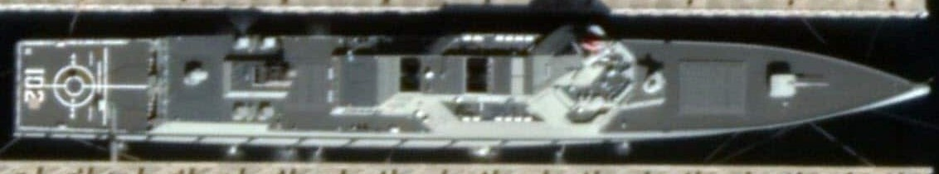
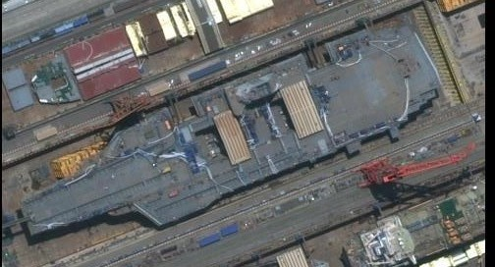

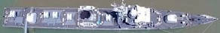


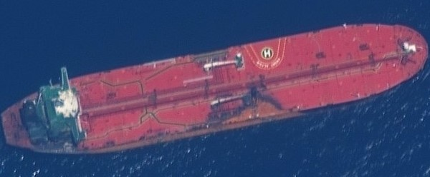
Future Development/Capabilities
Vessel Typing and Classification
Destroyer
Renhai Class
Type 055
...
Military
Aircraft carrier
Type 003
...
Ship
Submarine
Jin Ballistic Missile Submarine
Type 094
...
Frigate
Jiangkai II Frigate
Type 054A
Commercial
Container Ship
...
Tugboat
...
Oil Tanker

Slide 18
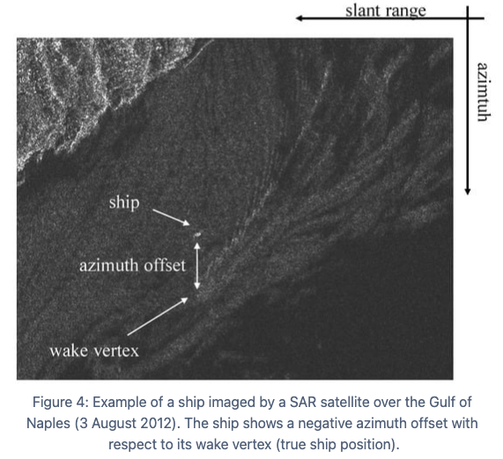
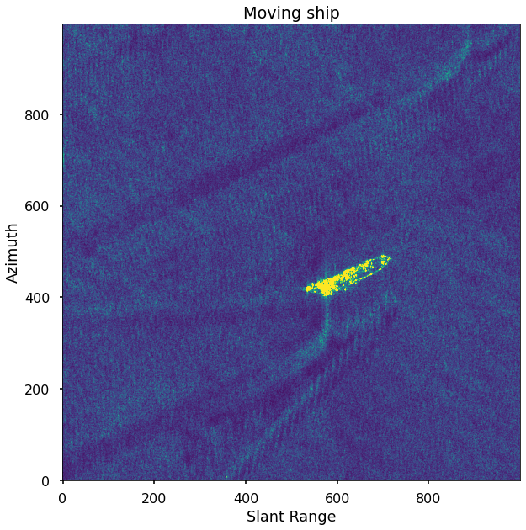
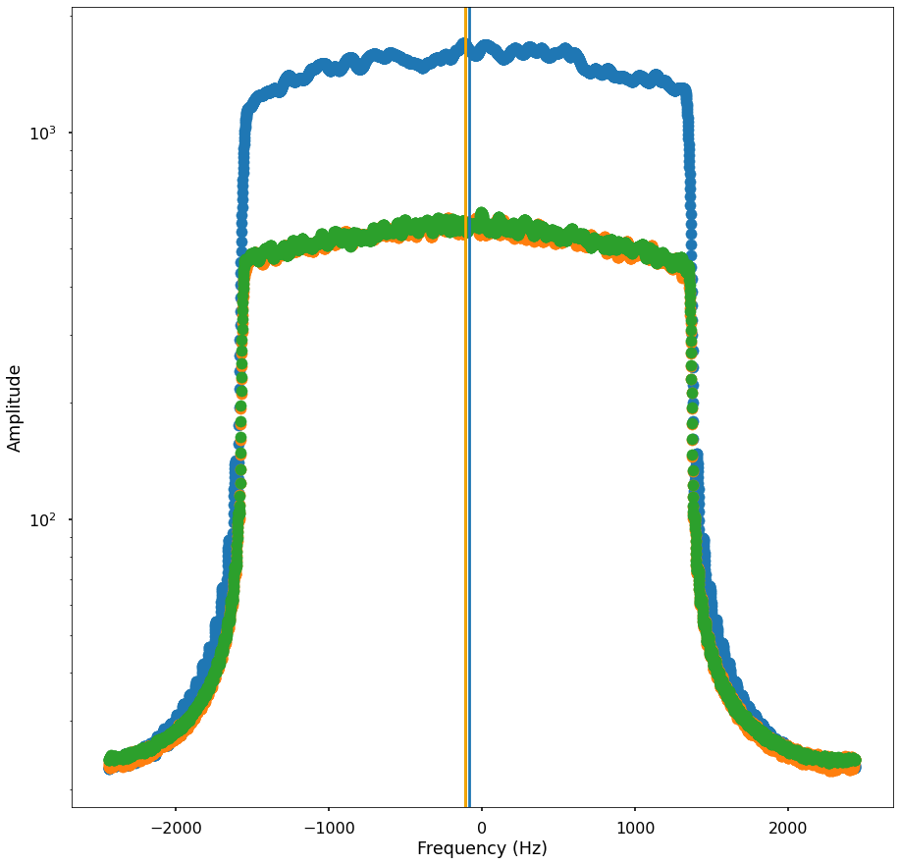
Future Development/Capabilities
SAR Single Image Speed Estimation – two methods
1. Range Doppler Method
Difference in signal sent from sensor and signal received in the phase information is used to calculate speed
Comparable to how a traffic speed gun works
2. Wake Pattern Analysis
Azimuth displacement from centerline of the vessel wake
estimated availability 8 -16 months

